Slide 1


MASTERING CLAUDE CODE

Slide 2














Instructor Introduction
550,000+ Students
M.A.Sc., Ph.D., MBA
260,000+ Subs, 4M views
Dr. Ryan Ahmed Professor & Best-selling Instructor
© All rights reserved for Dr. Ryan Ahmed @Stemplicity Inc.
AI & EV/AV

Slide 3

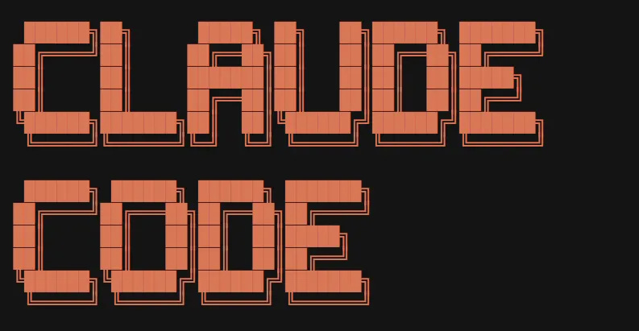



AI Agents
AI agents are intelligent systems that take a goal, plan the steps, and autonomously execute them using tools & knowledge with minimal human input.
AI Agent(s)
Input
Analyze Tesla (TSLA) & Build a website
Agent Teams
Researcher: price + 3 news
Analyst: drivers & verdict
Developer: Build a website
© All rights reserved for Dr. Ryan Ahmed @Stemplicity Inc.
Planning
Tools, Skills, Plugins
Memory

Slide 4
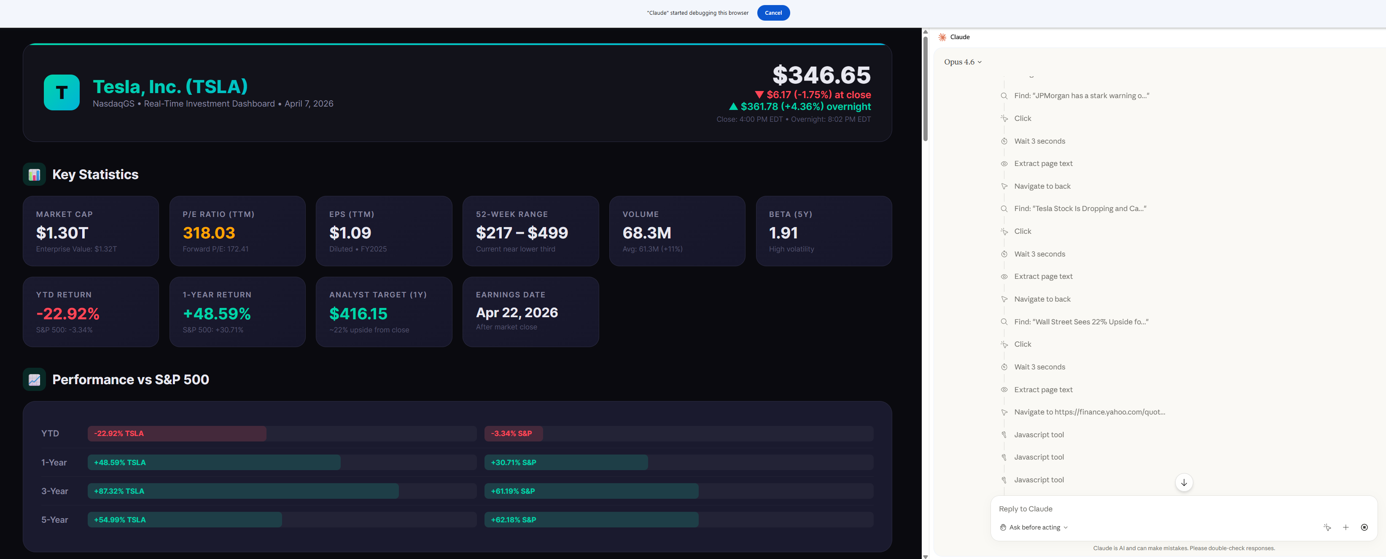
Claude Agent Demo
© All rights reserved for Dr. Ryan Ahmed @Stemplicity Inc.

Slide 5
COURSE OUTLINE

Slide 6
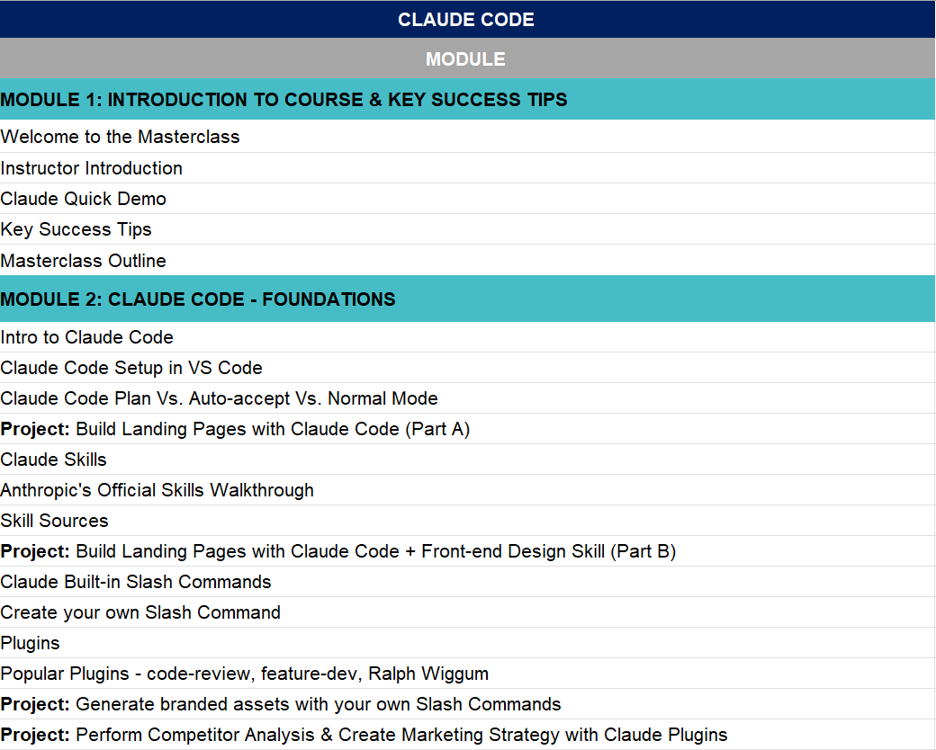
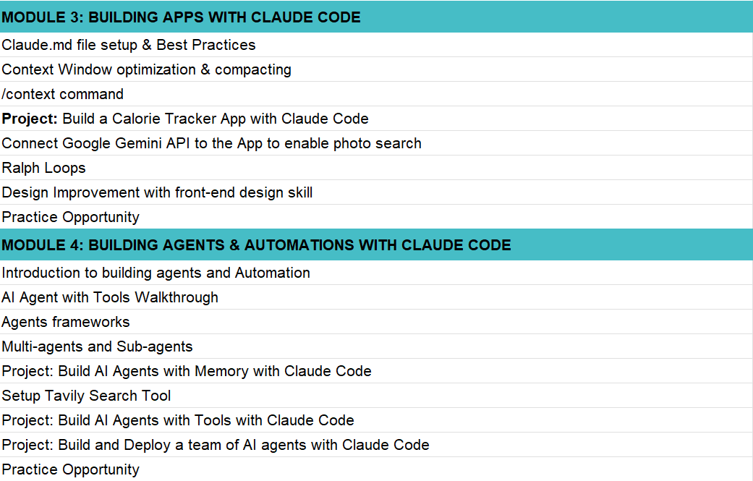
Course Outline
Check out the course outline “Claude Code - Outline.xlsx”
© All rights reserved for Dr. Ryan Ahmed @Stemplicity Inc.

Slide 7
COURSE KEY SUCCESS TIPS

Slide 8
Success Tips
Learn by Doing!
Build a Portfolio of Projects
Solve Practice Opportunities
Leverage LinkedIn to share your work & maximize Reach!
© All rights reserved for Dr. Ryan Ahmed @Stemplicity Inc.
LinkedIn Link: https://www.linkedin.com/in/dr-ryan-ahmed/

Slide 9
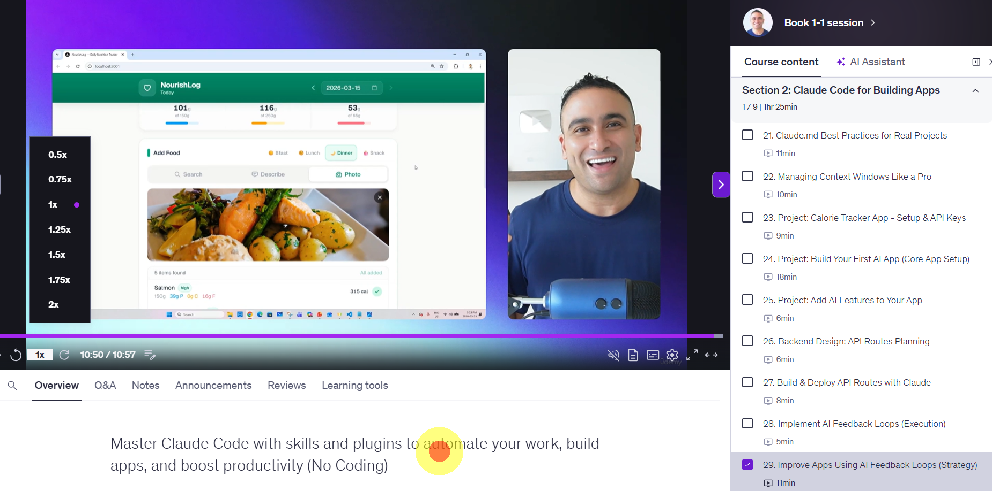
Change video Speeds
You have the option to play lectures at different speeds: (.5x, 1x, 1.25x, 1.5x or 2x)
In the bottom-left corner of the video, you can change the speed of the video.
© All rights reserved for Dr. Ryan Ahmed @Stemplicity Inc.

Slide 10
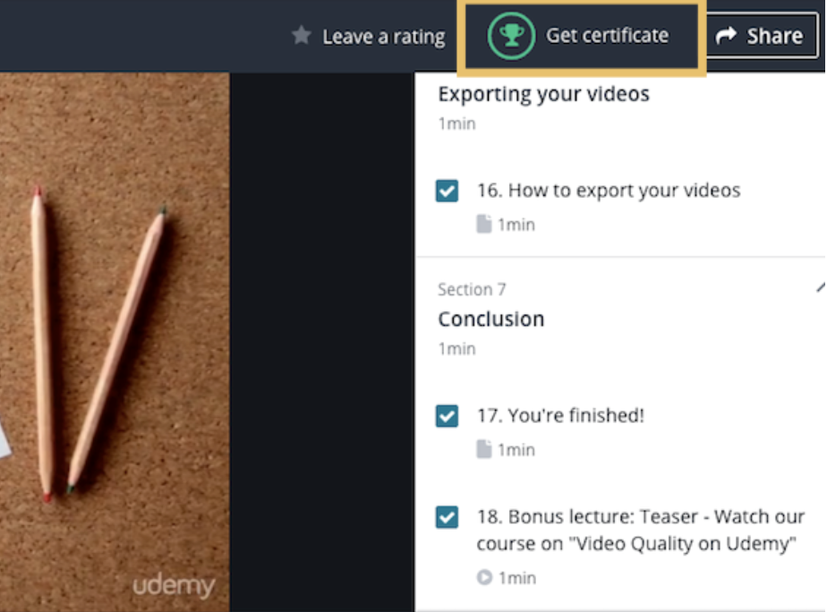
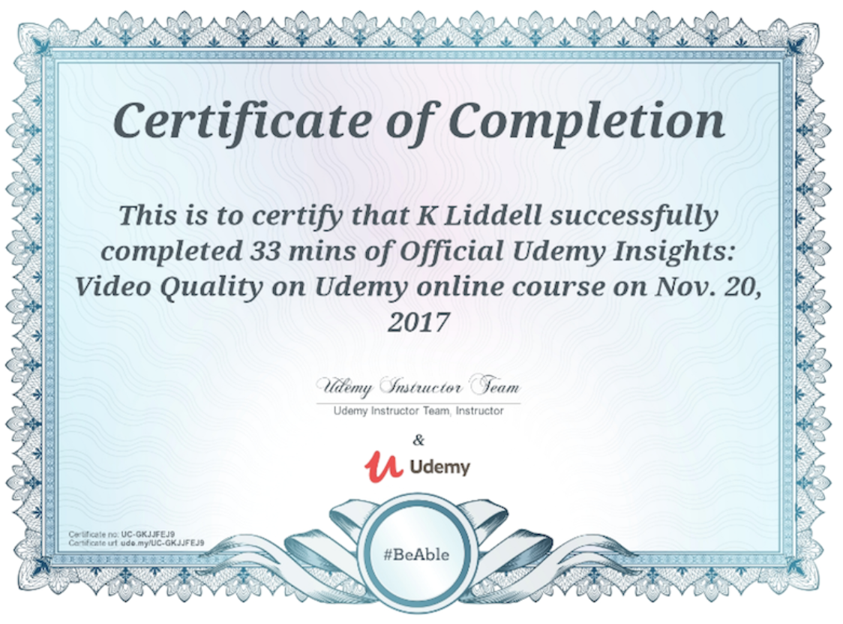
How do you get the Certificate of Completion?
When you complete all course modules, you will receive a certificate of completion.
© All rights reserved for Dr. Ryan Ahmed @Stemplicity Inc.

Slide 11
STATE OF AGENTIC AI

Slide 12
"6 months ago, building a website took a developer ~1–2 days.
Today, a team of AI agents designs, builds, tests, and deploys it in 10 minutes."
© All rights reserved for Dr. Ryan Ahmed @Stemplicity Inc.

Slide 13
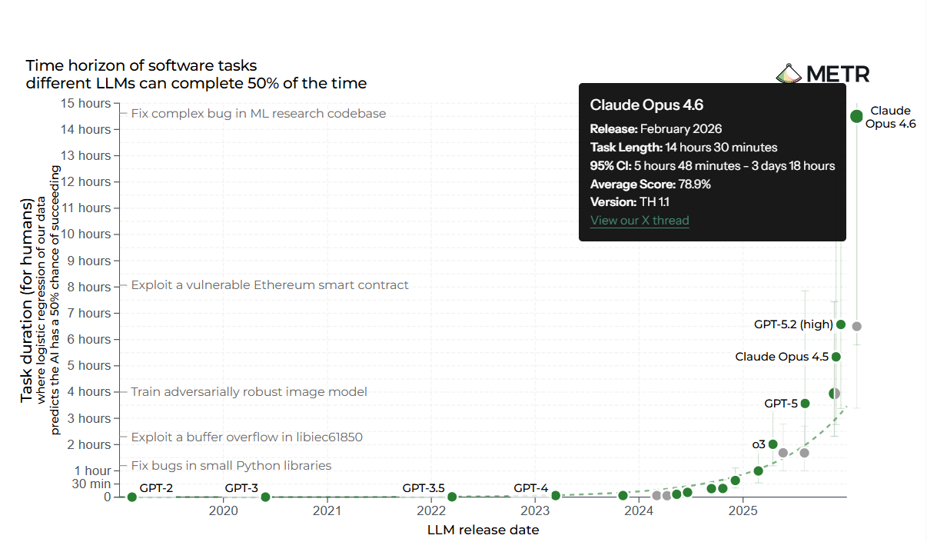
AI Can Now Work a Full Shift
© All rights reserved for Dr. Ryan Ahmed @Stemplicity Inc.
Source: https://metr.org/blog/2025-03-19-measuring-ai-ability-to-complete-long-tasks/

Slide 14
White Collar Work is Being Rewritten by AI Agents
We’re moving from developers writing every line of code to AI agents designing, building, and deploying full websites and applications.
2024
2025
2026-2027
Manual Era
AI-Assisted Era
Agentic Era
© All rights reserved for Dr. Ryan Ahmed @Stemplicity Inc.
Days
per deliverable
Hours
per deliverable
Minutes
per deliverable
→
→
Developers do the work
HTML, CSS, JS, debugging
Developers use AI
Copilot, ChatGPT
AI Agents run workflows
Design → Code → Test → Deploy
Outputs
Static sites, custom builds
Outputs accelerate
Templates, faster builds
End-to-end:
Prompt → Live Website

Slide 15
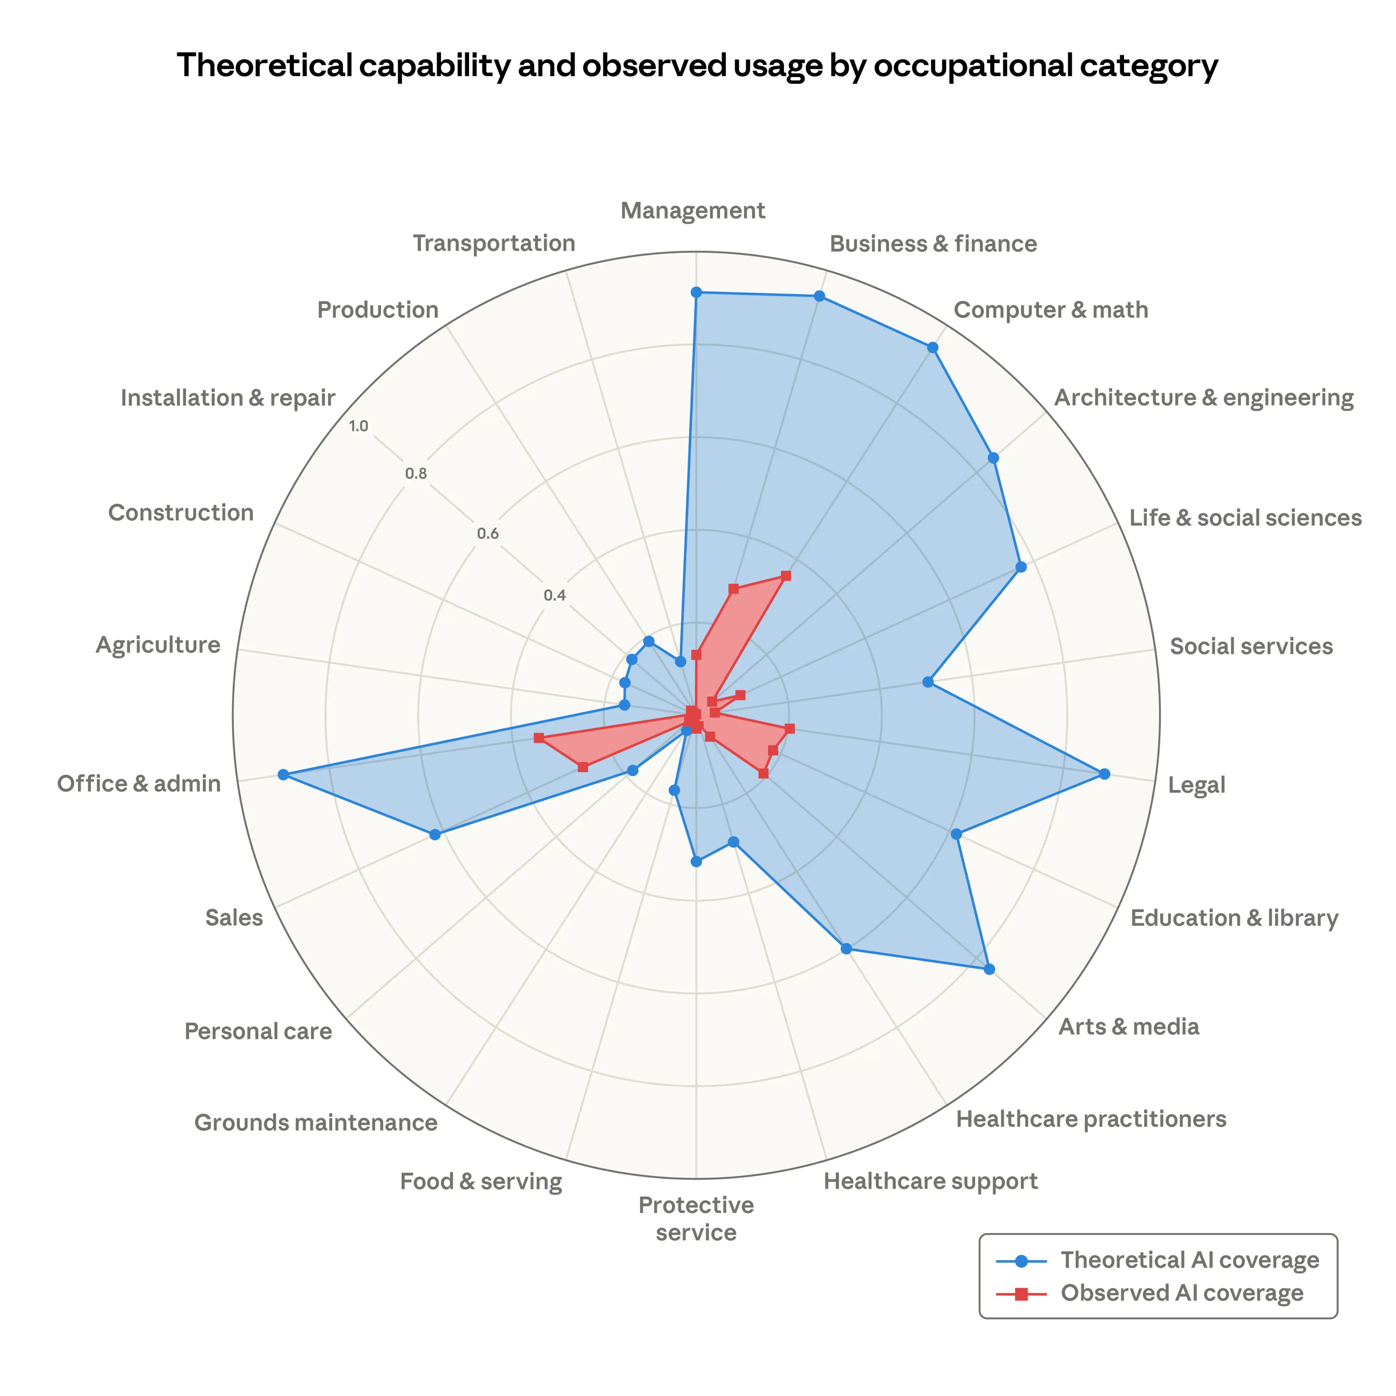
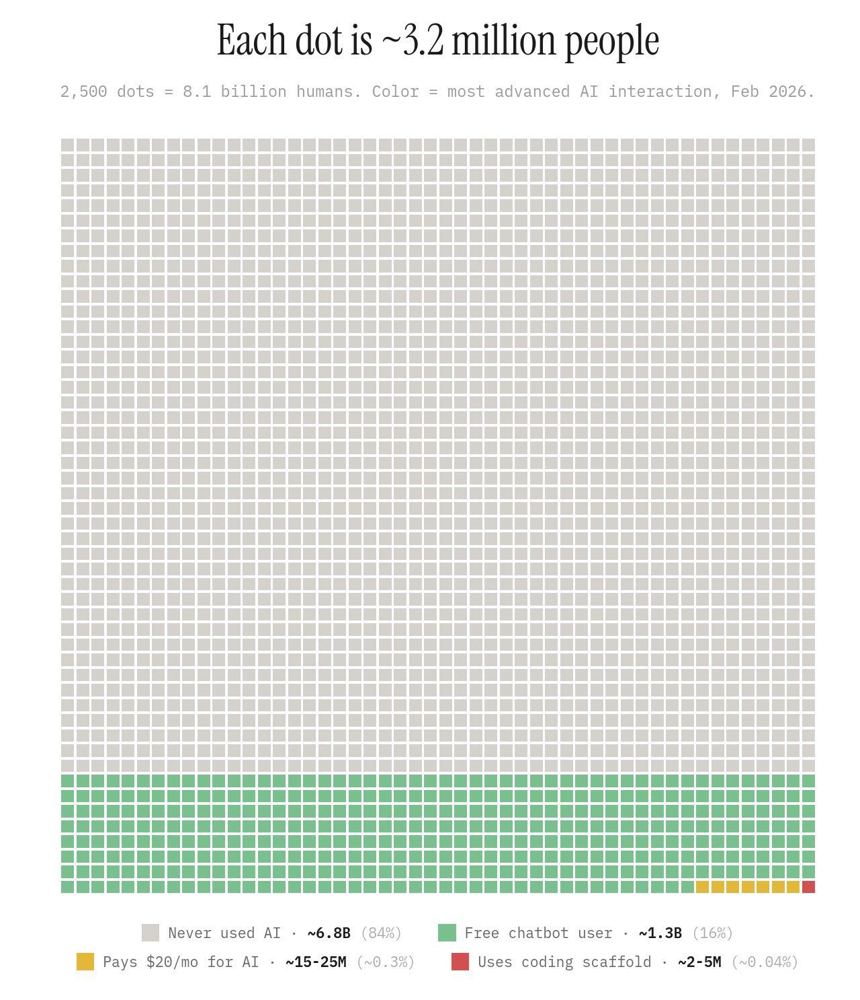
AI Jobs Exposure & You are Very Early!
© All rights reserved for Dr. Ryan Ahmed @Stemplicity Inc.
Source: https://www.anthropic.com/research/labor-market-impacts

Slide 16
Thank you!

